Slide 1
Biological analogy and some main ideas
The brain is composed of a mass of interconnected neurons
each neuron is connected to many other neurons
Neurons transmit signals to each other
Whether a signal is transmitted is an all-or-nothing event (the electrical potential in the cell body of the neuron is thresholded)
Whether a signal is sent, depends on the strength of the bond (synapse) between two neurons

Slide 2
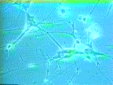
How Does the Brain Work ? (1)
NEURON
- The cell that performs information processing in the brain.
- Fundamental functional unit of all nervous system tissue.

Slide 3
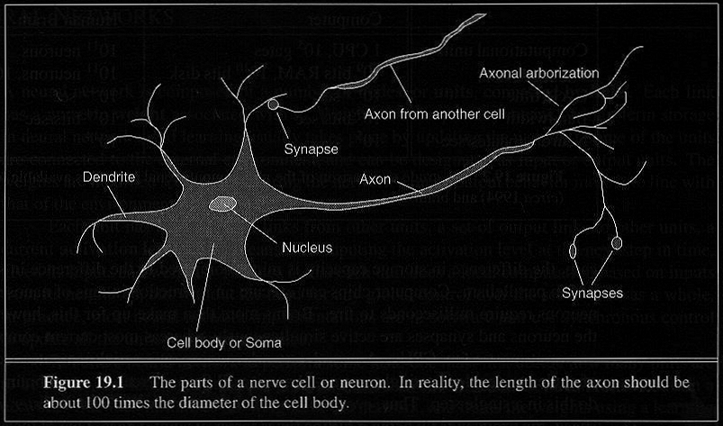
How Does the Brain Work ? (2)
Each consists of :
SOMA, DENDRITES, AXON, and SYNAPSE.

Slide 4
Brain vs. Digital Computers (1)
Computers require hundreds of cycles to simulate
a firing of a neuron.
- The brain can fire all the neurons in a single step.
Parallelism
- Serial computers require billions of cycles to
perform some tasks but the brain takes less than
a second.
e.g. Face Recognition

Slide 5
2011 Comparison of “Brainpower”

Slide 6
History
1943: McCulloch & Pitts: neurons can be combined to construct a Turing machine (using ANDs, Ors, & NOTs)
1958: Rosenblatt shows that perceptrons will converge if what they are trying to learn can be represented
1969: Minsky & Papert showed the limitations of perceptrons
1985: Backpropagation algorithm revitalizes the field
2000s: Deep learning

Slide 7
Definition of Neural Network
A Neural Network is a system composed of
many simple processing elements operating in
parallel which can acquire, store, and utilize
experiential knowledge.

Slide 8
Neurons, Nodes, Units
- Each element of a NN is a node or neuron, or unit.
- Units are connected by edges or connections or links.
- Each link has a numeric weight.

Slide 9
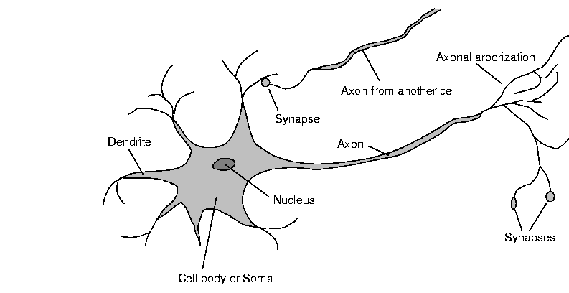
Biological Neurons

Slide 10
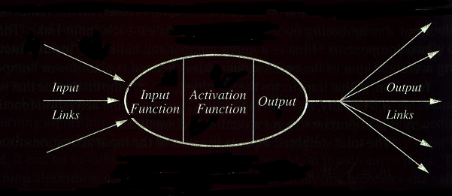
Computing Elements
A typical unit:

Slide 11
Planning in building a Neural Network
Decisions must be taken on the following:
- The number of units to use.
- The type of units required.
- Connection between the units.

Slide 12
Learning: What is to be done?
- Initializing the weights.
- Use of a learning algorithm.
- Set of training examples.
- Encode the examples as inputs.
- Convert output into meaningful results.

Slide 13
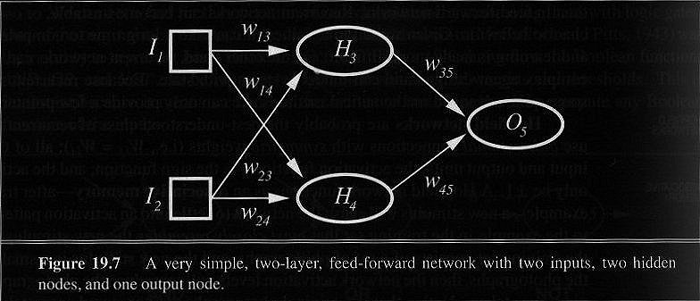
Neural Network Example
A two-layer (=one-hidden-layer) feed-forward network with two inputs, two hidden nodes, and one output node.

Slide 14
Simple Computations in this network
- There are 2 types of components: Linear and Non-linear.
- Linear: Input function
- calculate weighted sum of all inputs.
- Non-linear: Activation function
- transform sum into activation level.

Slide 15


Calculations
Input function:
Activation function g:

Slide 16
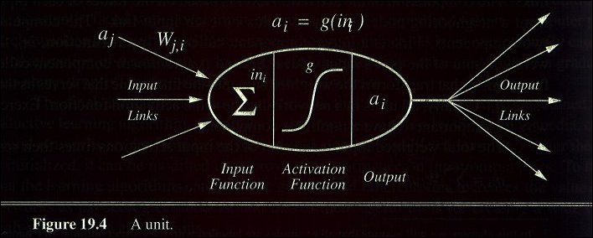
A Computing Unit: Example
Figure 19.4. A unit

Slide 17
Activation Functions
- Use different functions to obtain different models.
- Common choices :
1) Step function
2) Sign function
3) Sigmoid (and tanh) function
4) ReLU(x)= max(x, 0), and its variants
- An output of 1 represents firing of a neuron down the axon.

Slide 18
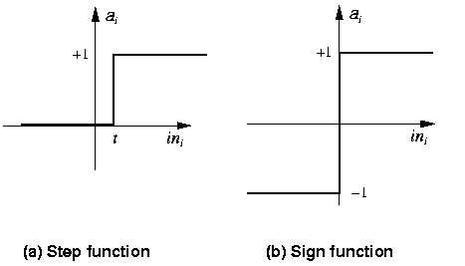
Step Function Perceptrons

Slide 19
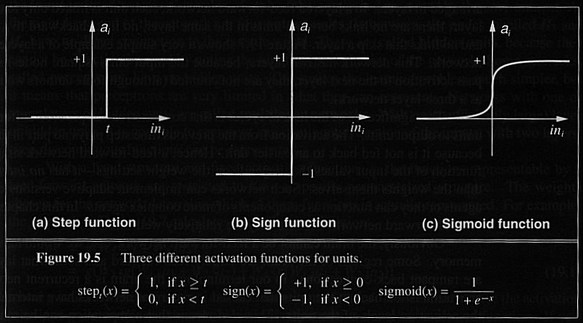
3 Activation Functions

Slide 20

Notation

Slide 21
Notation (cont.)

Slide 22
Operation of individual units
Output_{i} = f(Dot product of input vector with i^{th} weight vector)
where f(x) is a threshold (activation) function, e.g.,
sigmoid (x) = 1 / (1 + e^{-x})
tanh (x) = (e^{x} - e^{-x} )/ (e^{x} + e^{-x})
ReLU(x) = max(0, x)

Slide 23
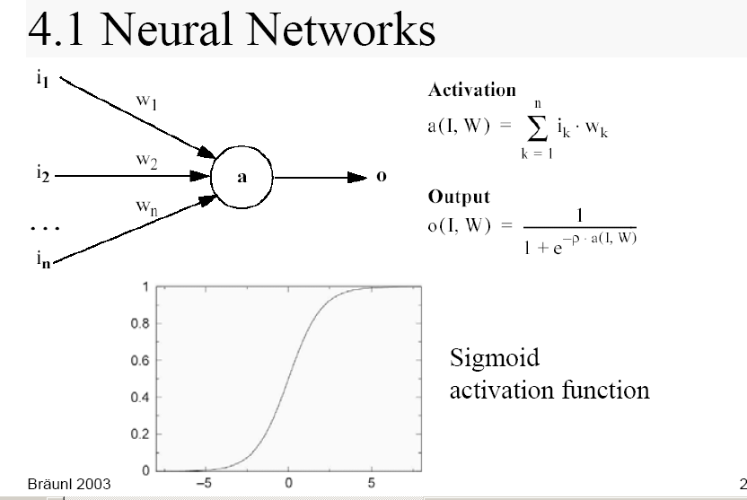
Artificial Neural Networks

Slide 24
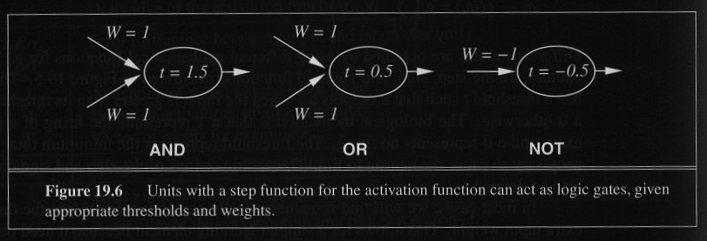
Units in Action
- Individual units representing Boolean functions

Slide 25
Network Structures
Feed-forward neural nets:
Links in one direction.
Layers
No cycles
Recurrent neural nets:
Links can go anywhere
Arbitrary topologies
Cycles

Slide 26
Feed-forward Networks
- Arranged in layers.
- Each unit is linked only in the unit in next layer.
No units are linked between the same layer, back to
the previous layer or skipping a layer.
- Computations can proceed uniformly from input to
output units.
- No internal state exists.

Slide 27
Feed-Forward Example
H3
H5
I1
W₃₅ = 1
W₁₃ = -1
t = -0.5
t = 1.5
I1
W₅₇ = 1
W₂₅ = 1
O7
t = 0.5
W₁₆ = 1
I2
W₆₇ = 1
W₂₄= -1
t = -0.5
t = 1.5
W₄₆ = 1
H4
H6
Inputs skip the layer in this case

Slide 28
Multi-layer Networks and Perceptrons
- Networks without hidden layer are called perceptrons.
- Perceptrons are very limited in what they can represent, but this makes their learning problem much simpler.
- Have one or more layers of hidden units.
- With two possibly very large hidden layers, it is possible to implement any function.

Slide 29
Perceptrons
- First studied in the late 1950s.
- The only efficient learning element at that time was
for single-layered networks.
- Today, used as a synonym for a single-layer,
feed-forward network (no hidden nodes, no cycles)

Slide 30
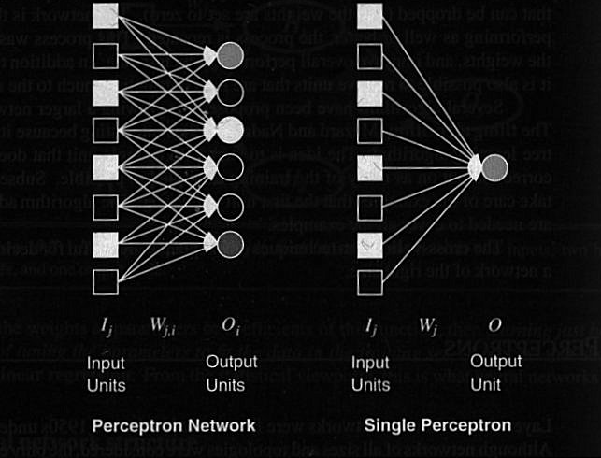
Fig. 19.8. Perceptrons

Slide 31
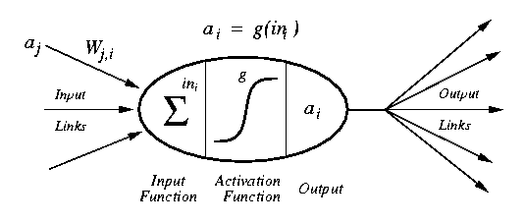
Perceptrons

Slide 32
Perceptron learning rule
Teacher specifies the desired output for a given input
Network calculates what it thinks the output should be
Network changes its weights in proportion to the error between the desired & calculated results
Δw_{i,j} = α * [teacher_{i} - output_{i}] * input_{j}
where:
α is the learning rate;
teacher_{i} - output_{i} is the error term;
and input_{j} is the input activation
w_{i,j =} w_{i,j} + Δw_{i,j}
Delta rule

Slide 33
Adjusting perceptron weights
Δw_{i,j} = α * [teacher_{i} - output_{i}] * input_{j}
miss_{i} is (teacher_{i} - output_{i})
Adjust each w_{i,j} based on input_{j} and miss_{i}
The above table shows adaptation.
_{Incremental learning.}

Slide 34
Node biases
A node’s output is a weighted function of its inputs
What is a bias?
How can we learn the bias value?
Answer: treat them like just another weight

Slide 35
Training biases (Θ)
A node’s output:
1 if w₁x₁ + w₂x₂ + … + w_{n}x_{n} >= Θ
0 otherwise
Rewrite
w₁x₁ + w₂x₂ + … + w_{n}x_{n} - Θ >= 0
w₁x₁ + w₂x₂ + … + w_{n}x_{n} + Θ(-1) >= 0
Hence, the bias is just another weight whose activation is always -1
Just add one more input unit to the network topology
bias

Slide 36
Classification problems: Perceptron convergence theorem
If a set of <input, output> pairs are learnable (representable), the perceptron learning rule will find the necessary weights
in a finite number of steps
independent of initial weights
However, a single layer perceptron can only learn linearly separable concepts

Slide 37
Linear separability
Consider a perceptron
Its output is
1, if W₁X₁ + W₂X₂ > Θ
0, otherwise
In terms of feature space
hence, it can only classify examples if a line (hyperplane more generally) can separate the positive examples from the negative examples

Slide 38
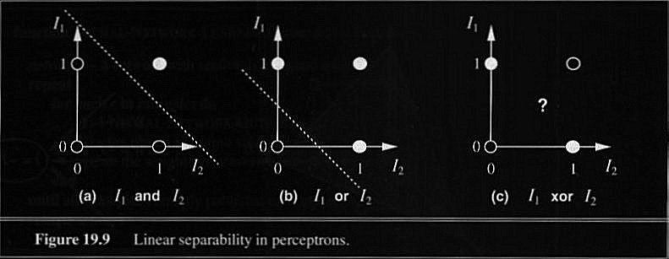
Separability and XOR trouble
“AND”, “OR” functions are linearly separable, not “XOR”

Slide 39
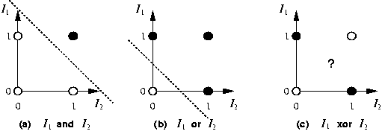
AND and OR linear Separators

Slide 40
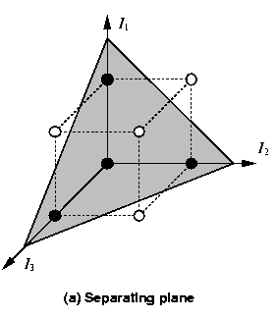
Separability of 3-dim. data
majority

Slide 41
How do we compute XOR?

Slide 42
Perceptrons & XOR
XOR function
no way to draw a line to separate the positive from negative examples

Slide 43
Linear Separability
Bad news:
- Most problems are not linearly separable
Good news:
- There is a perceptron algorithm that will learn
any linearly separable function, given enough
training examples.
(Approach: Somewhat similar to k-means clustering; start somewhere, and iteratively improve the current solution.)

Slide 44
Perceptron Learning Algorithm
(assuming two classes, labeled +1 and -1)
Initialize weights randomly;
While (any data is misclassified) do:
Present a data point;
Evaluate performance of Perceptron on this data point;
If incorrectly classified, new weight vector = old weight vector +/- (learning rate)(this data point)
[Add or subtract depending on the sign of the desired class]
==============================================
IF THE TWO CLASSES ARE LINEARLY SEPARABLE, THIS ALGORITHM IS GUARANTEED TO CONVERGE TO A CORRECT SOLUTION!

Slide 45
Generic NN Learning Algorithm
Initialize weights randomly;
While (TERMINATION CONDITIONS) do:
Present a subset of data (“batch”) to the NN;
Evaluate performance of NN on this batch;
Make small changes to the weights that are expected to improve future performance on this batch;

Slide 46
Generic NN Learning Algorithm: Details
Termination conditions:
Satisfactory performance (e.g., MSE<0.01)
Computational effort (e.g., 1 million iterations or “epochs”)
Convergence (e.g., <0.0001 MSE improvement in 10 iterations)
Batch size choices:
1 data point
All data
100-300 data points
Performance evaluation:
MSE
Cross-entropy
Perplexity
Weight change rule:
Stochastic Gradient Descent
Variants of SGD such as “ADAM”

Slide 47
Need for hidden units
If there is one layer of enough hidden units, the input can be recoded (perhaps just memorized; example)
This recoding allows any mapping to be represented
Problem: how can the weights of the hidden units be trained?

Slide 48
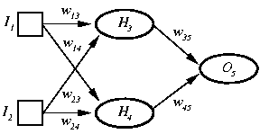
2-2-1 Feedforward NN (with a hidden layer containing 2 nodes)

Slide 49
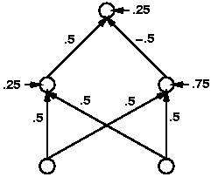
XOR Solution with 2-2-1 FFNN

Slide 50
N-layer FeedForward Network
Layer 0 is input nodes
Layers 1 to N-1 contain hidden nodes
Layer N contains output nodes
All nodes at any layer k are connected to all nodes at layer k+1
There are no cycles

Slide 51
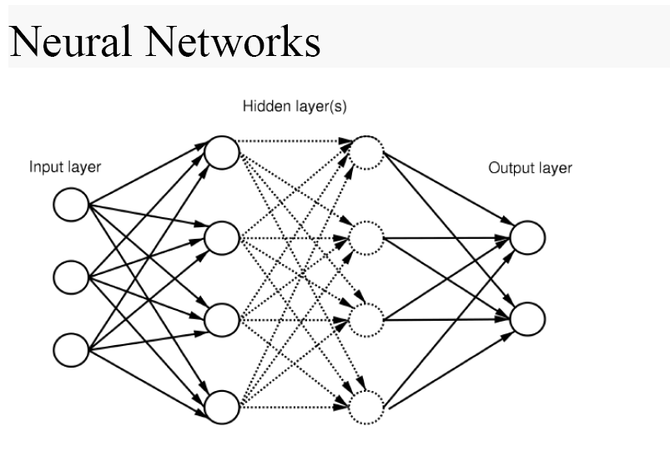
Feed-forward NN with two hidden layers

Slide 52
“Net weighted input” to a node k
Let c be the “bias weight” (or negative threshold) associated with node k.
(Equivalently, pretend there is an extra node leading into node k with activation=1 and weight=c.)
Let S be the set of nodes from which there are connections with weight vector W to node k (in the following layer).
When an input vector X is presented to the network, let V be the resulting activations of nodes in S.
The net weighted input to node k is the dot product V.W+c.

Slide 53
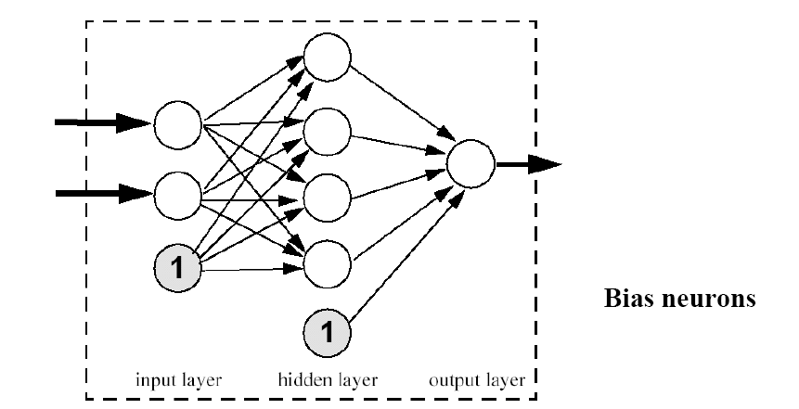
Bias Neurons
bias neuron in input layer

Slide 54
What do various nodes in a FFNN do?
Input nodes do nothing. Every other node applies a node function to its net weighted input.
Output nodes generate output in a format suitable for the problem, e.g., binary ({0,1} or {-1,1}) or continuous (in [0,1] or [-1,1]), applying a threshold, sigmoid, or softmax function to the net weighted input.
Hidden nodes apply nonlinear functions (sigmoid, ReLU, Gaussian, or a variant) to the net weighted input.

Slide 55
Most frequently used node functions
Linear threshold unit: {0,1}
Sign function: {-1,1} or {-1, 0, 1}
Logistic sigmoid function: [0,1]
Tanh: [-1, 1]
Softmax: [0, 1]—unlike the sigmoid, this is used when multiple non-negative outputs exist, dividing each value by the sum.
Rectified Linear Unit (ReLU): [0, infinity] –computed as max(0, net weighted input)

Slide 56
Gradient Descent
Let W be a weight matrix (or a vector of other model parameters).
Let E be the performance measure we wish to minimize (e.g., MSE).
New W = Old W – (learning rate) dE/dW
[Abusing some notational conventions]
Usually, the chain rule helps calculate derivatives: if B1 and B2 are intermediaries between A and C, then dA/DC = (dA/dB1)(dB1/dC) + (dA/dB2)(dB2/dC)

Slide 57
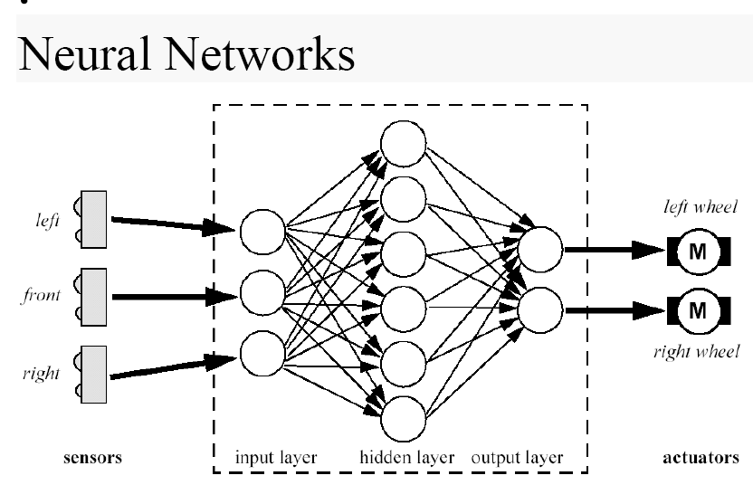
Reactive architecture based on NN for a simple robot
Braitenberg Vehicles
Quantum Neural BV

Slide 58
Backpropagation
1960: Henry J. Kelley
1967: Shun’Ichi Amari
1969: Bryson and Ho
1982: Paul Werbos
1986: Rumelhart, Hinton, & Williams
Just gradient descent, using chain rule of differentiation!

Slide 59
Backpropagation Learning Principles: Hidden Layers and Gradients
There are two differences for the updating rule :
1) The activation of the hidden unit is used instead of the
input value.
2) The rule contains a term for the gradient of the activation
function.

Slide 60
Backpropagation Network training
1. Initialize network with random weights
2. For all training cases (called examples):
a. Present training inputs to network and calculate output
b. For all layers (starting with output layer, back to input layer):
i. Compare network output with correct output
(error function)
ii. Adapt weights in current layer
This is what you want

Slide 61
Backpropagation Learning Details
Method for learning weights in feed-forward (FF) nets
Can’t use Perceptron Learning Rule
no teacher values are possible for hidden units
Use gradient descent to minimize the error
propagate deltas to adjust for errors
backward from outputs
to hidden layers
to inputs
forward
backward

Slide 62
Backpropagation Algorithm – Main Idea – error in hidden layers
The ideas of the algorithm can be summarized as follows :
Computes the error term for the output units using the
observed error.
2. From output layer, repeat
propagating the error term back to the previous layer and
updating the weights between the two layers
until the earliest hidden layer is reached.

Slide 63
Backpropagation Algorithm (“stochastic GD” with batch size =1)
Initialize weights (typically random!)
While ( TERMINATION CRITERION ) do:
For each example e in training set do
Forward pass to compute network outputs;
Compute “loss” or error function;
Backward pass to calculate changes to weights, starting with outermost layer, steadily moving towards input layer;
Update all weights.

Slide 64
Gradient Descent
Think of the N weights as a point in an N-dimensional space
Add a dimension for the observed error
Try to minimize your position on the “error surface”

Slide 65
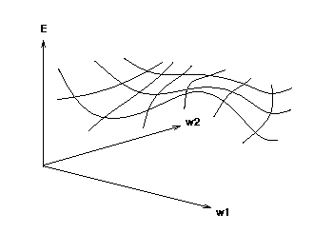
Error Surface
error
weights
Error as function of weights in multidimensional space

Slide 66
Gradient Descent in NNs
Compute gradient:
Grad_{E} = [dE/dw1, dE/dw2, . . ., dE/dwn]
“Descent”: Change i-th weight by
delta_{wi} = -alpha * dE/dwi
Choice of node functions in NNs is driven by the need for a derivative!
If a function is differentiable “almost everywhere” (e.g., piecewise linear functions), choose a value randomly at the points where there is no derivative.

Slide 67
Updating hidden-to-output
We have teacher supplied desired values
delta_{wji} = α * a_{j} * (T_{i} - Oi) * g’(in_{i})
= α * a_{j} * (T_{i} - O_{i}) * O_{i} * (1 - O_{i})
for sigmoid the derivative is, g’(x) = g(x) * (1 - g(x))
derivative
alpha
Here we have general formula with derivative, next we use for sigmoid
miss

Slide 68
Updating interior weights
Layer k units provide values to all layer k+1 units
“miss” is sum of misses from all units on k+1
miss_{j} = Σ [ a_{i}(1- a_{i}) (T_{i} - a_{i}) w_{ji} ]
weights coming into this unit are adjusted based on their contribution
delta_{kj} = α * I_{k} * a_{j} * (1 - a_{j}) * miss_{j}
For layer k+1
Compute deltas

Slide 69
How do we pick α?
Tuning set, or
Cross validation, or
Small for slow, conservative learning, or
Adapt value during training, choosing biggest possible value that results in improvement.

Slide 70
Network size
Shallow NNs: 1-2 hidden layers
Deep NNs: hundreds of layers for difficult problems with huge amounts of available data
How many hidden units?
Too few ==> can’t learn
Too many ==> poor generalization

Slide 71
How big a training set?
Determine your target error rate, e
Success rate is 1- e
Typical training set approx. n/e, where n is the number of weights in the net
Example:
e = 0.1, n = 80 weights
training set size 800
trained until 95% correct training set classification
should produce 90% correct classification
on testing set (typical)

Slide 72
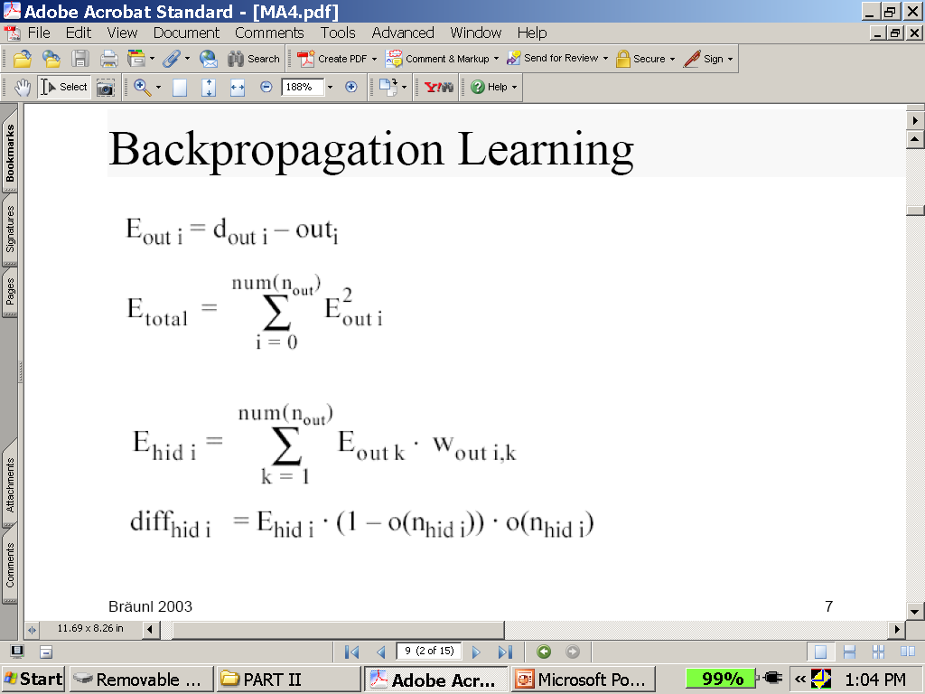
Backpropagation Learning Math
See next slide for explanation

Slide 73
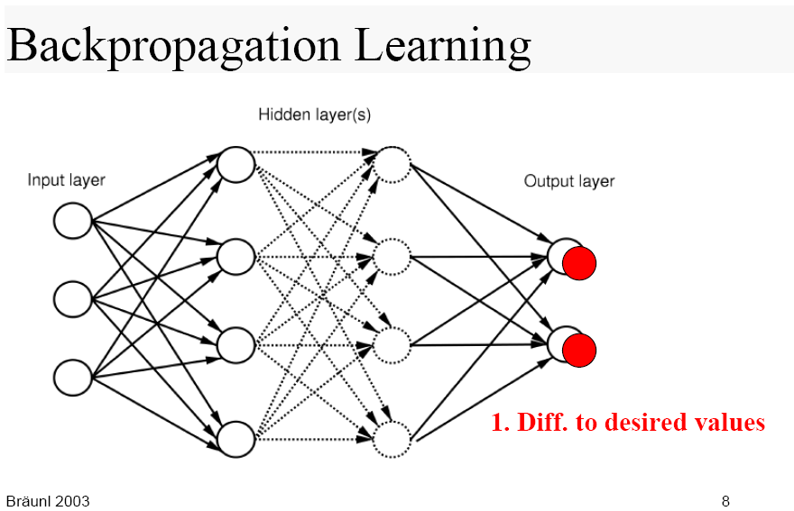
Visualization of Backpropagation learning
Backprop output layer

Slide 74
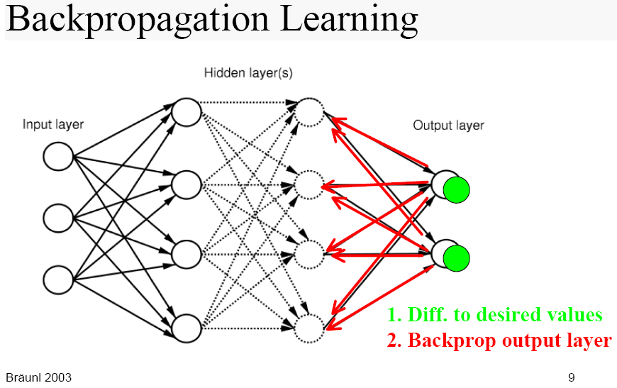

Slide 75
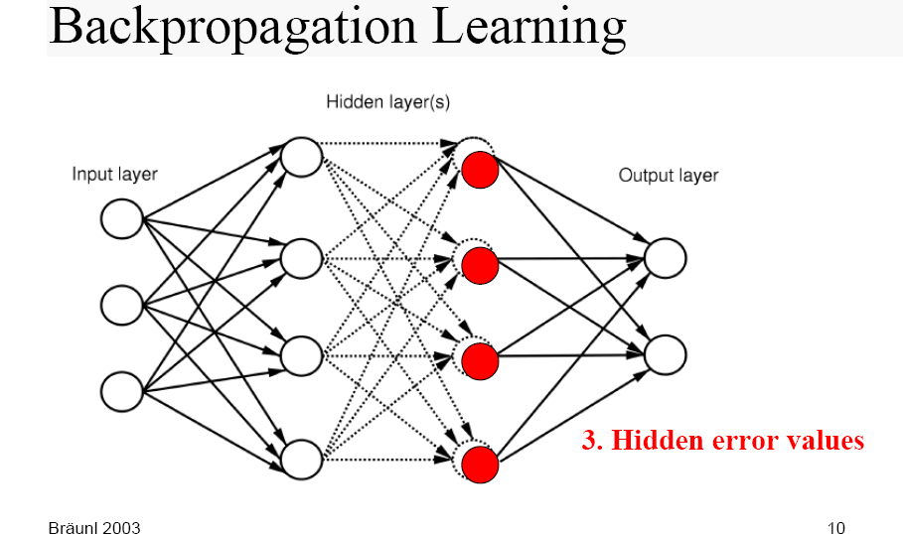

Slide 76
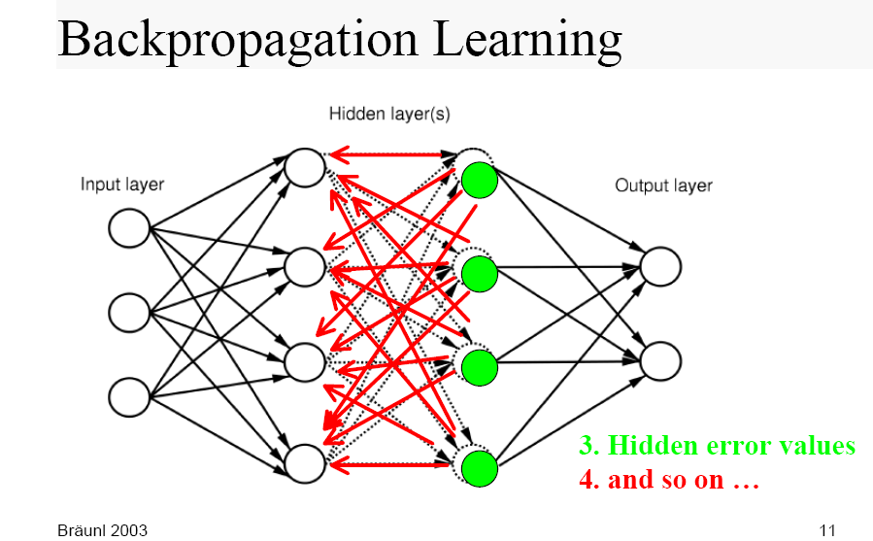

Slide 77
Summary
- Given enough units, any function can be represented
by Multi-layer feed-forward networks.
- Backpropagation learning works on multi-layer
feed-forward networks.
- Neural Networks are widely used in developing
artificial learning systems.

